Slide 1


Team EarlyBirds: HR Attrition Prediction System
Sairaj Dixit Yogananda Gone Nikshita Burde
Abhijit Joshi Avdhut Kulkarni
Confidential © 2022 Persistent Systems

Slide 2

OUTLINE
Problem Statement
Objective and scope of the project
Analytics approach and work flow
Data Sources
Business Values
Functionality
Architecture & Working Model
Integration
Prediction and Result
Q & A
Confidential © 2022 Persistent Systems

Slide 3
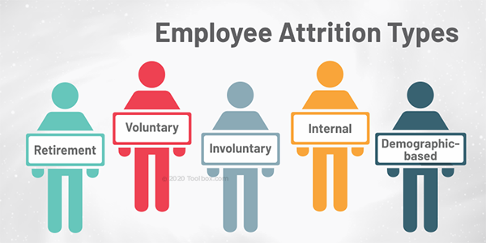
PROBLEM STATEMENT
The Great Resignation phenomenon of 2021 is causing high attrition of unplanned nature. It is a very challenging and costly affair to replace the employees who leave in an unplanned manner. Such high-risk employees, if identified in advance allow the organization time to plan and even take corrective actions to retain them.
Additional information – IBM HR Attrition Dataset: https://www.kaggle.com/anupjana/ibm-hr-employee-attrition-analysis-prediction
Confidential © 2022 Persistent Systems

Slide 4

OBJECTIVE AND SCOPE OF THE PROJECT
The objective of this project is to predict the attrition rate for each employee, to find out who's more likely to leave the organization.
It will help organizations to find ways to prevent attrition or to plan in advance the hiring of new candidate.
Attrition proves to be a costly and time consuming problem for the organization and it also leads to loss of productivity.
The scope of the project extends to companies in all industries.
Confidential © 2022 Persistent Systems

Slide 5
BLOCK DIAGRAM
Data Cleaning
Data Acquisition
Model Training
Model Evaluation
Deployment
Attrition Prediction
Performance Evaluation
Confidential © 2022 Persistent Systems

Slide 6
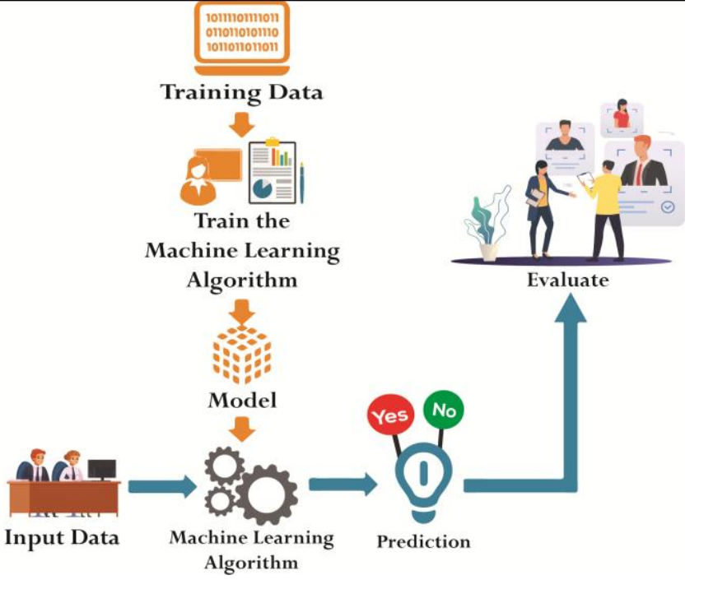
ARCHITECTURE DIAGRAM
Confidential © 2022 Persistent Systems

Slide 7
DATA SOURCES
For this project, an HR dataset named 'IBM HR Analytics Employee Attrition & Performance', has been picked, which is available on IBM website.
The data contains records of 1,470 employees.
It has information about employee's current employment status, the total number of companies worked for in the past, Total number of years at the current company and the current roles, Their education level, distance from home, monthly income, etc.
Confidential © 2022 Persistent Systems

Slide 8
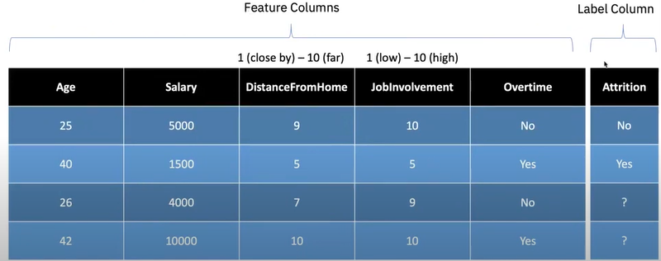
ANALYTICS APPROACH
Google Colab Notebook Link:
How to predict the Attrition?
EDA-Colab-Notebook
Confidential © 2022 Persistent Systems

Slide 9
WORK FLOW
First identify the features (variables / attributes) with in data available which is likely to impact attrition.
Select a model to predict employee attrition using the feature identified.
Detect the most high contributor/factor for employee attrition.
HR/Manager needs to work on the factor to reduce attrition or decide on backfill depending on the cost factor.
HR/Manager’s domain knowledge skill is leveraged to provide feedback to model for improvement in future prediction.
Confidential © 2022 Persistent Systems

Slide 10

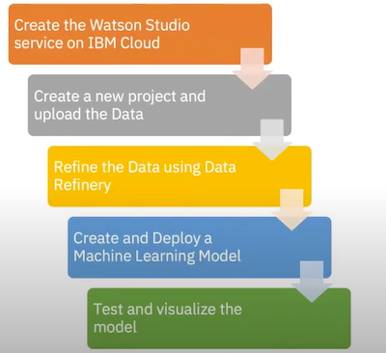
Demo
Workflow of HR Attrition Prediction Using IBM Watson Studio and IBM’s AutoAI Service
\ Random Forest Classifier Model – 85.9% Accuracy
\ Dataset reference: HR-Attrition-Prediction-IBM-Dataset
Confidential © 2022 Persistent Systems

Slide 11
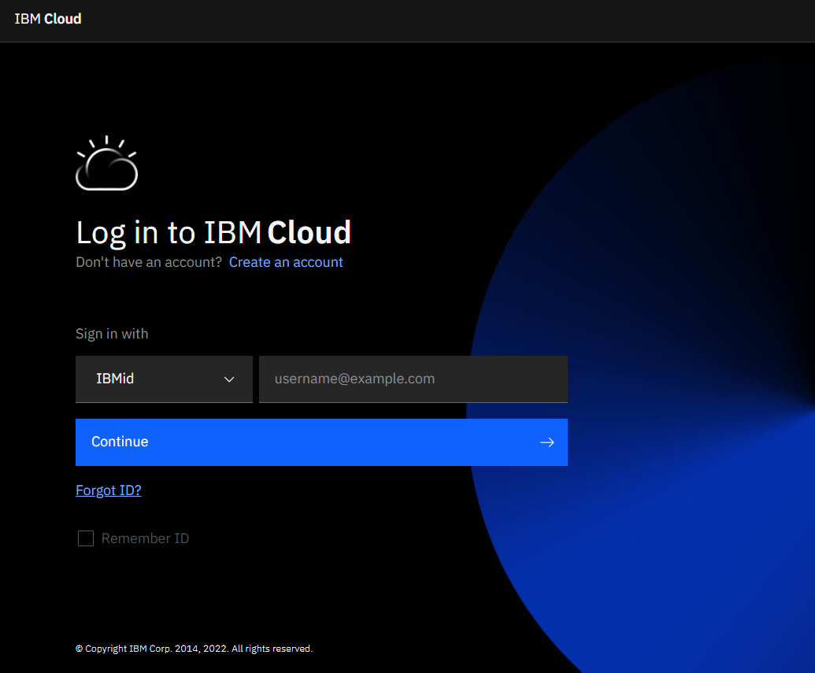

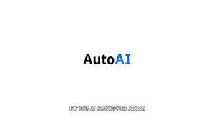
Confidential © 2022 Persistent Systems

Slide 12
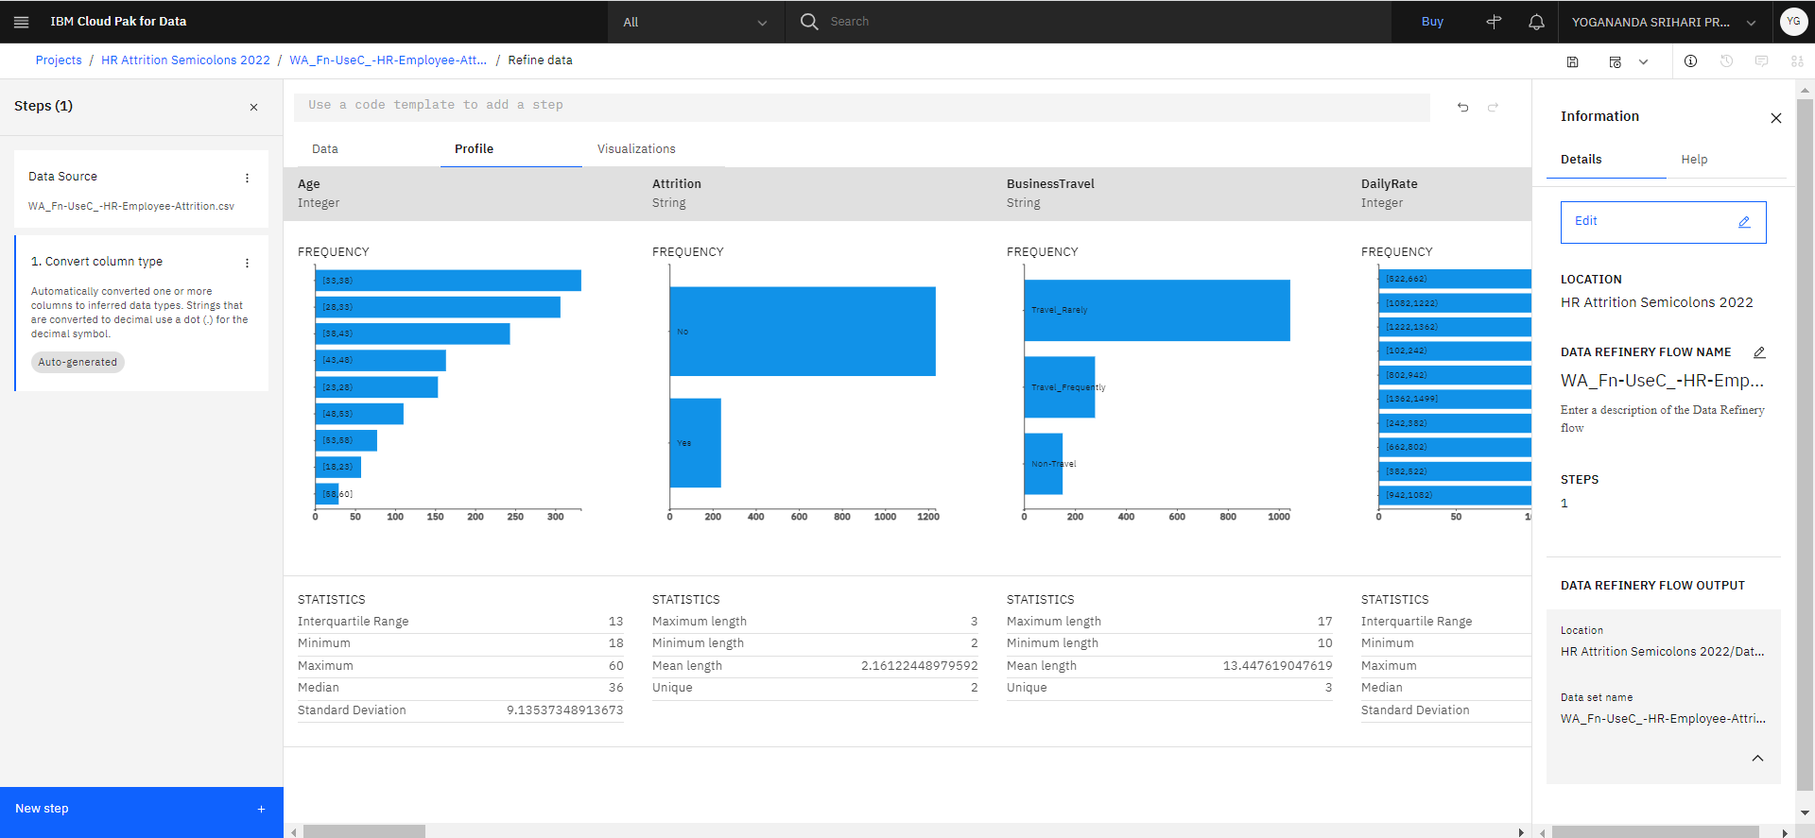
PREDICTION AND RESULT
Confidential © 2022 Persistent Systems

Slide 13
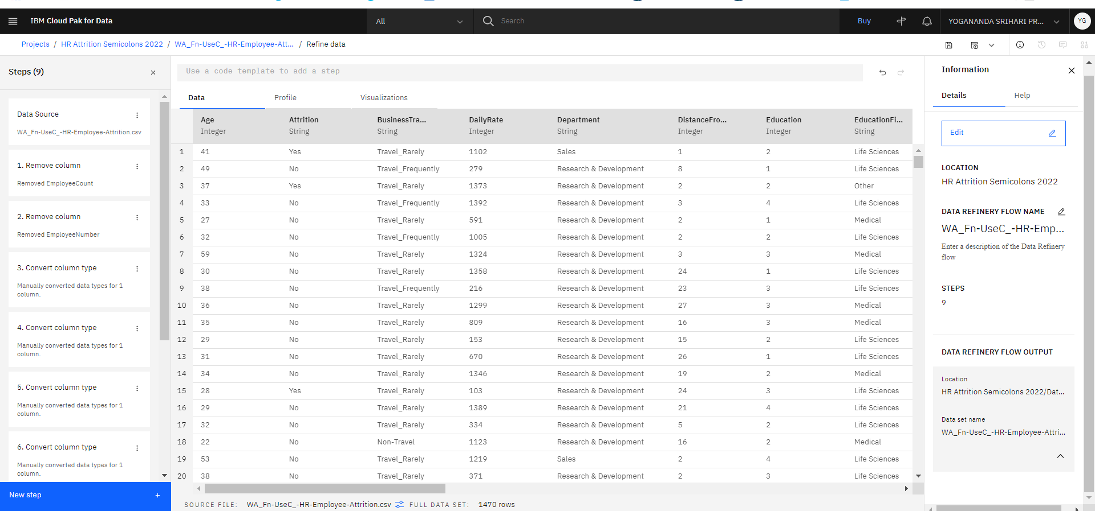
PREDICTION AND RESULT
Confidential © 2022 Persistent Systems

Slide 14
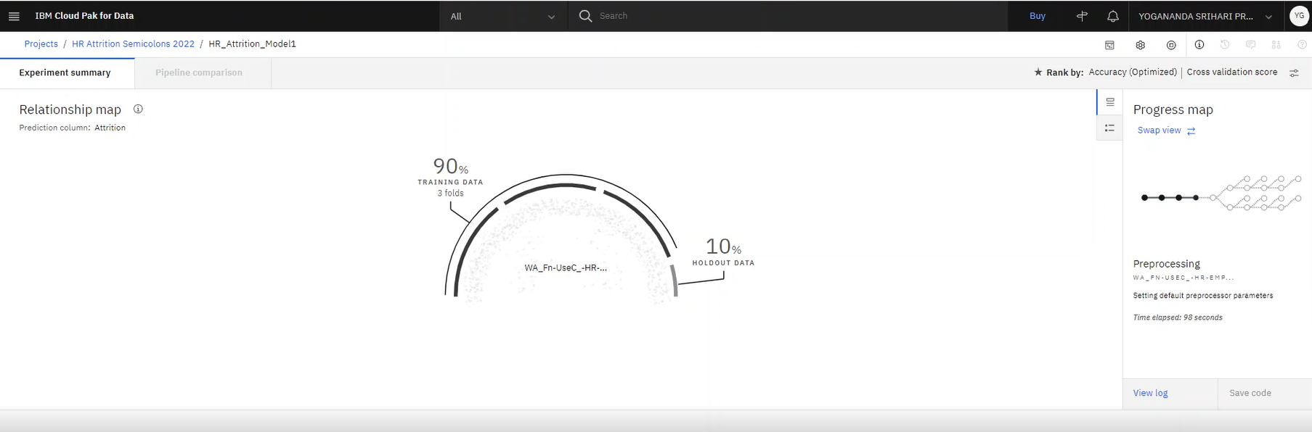
PREDICTION AND RESULT
Confidential © 2022 Persistent Systems

Slide 15
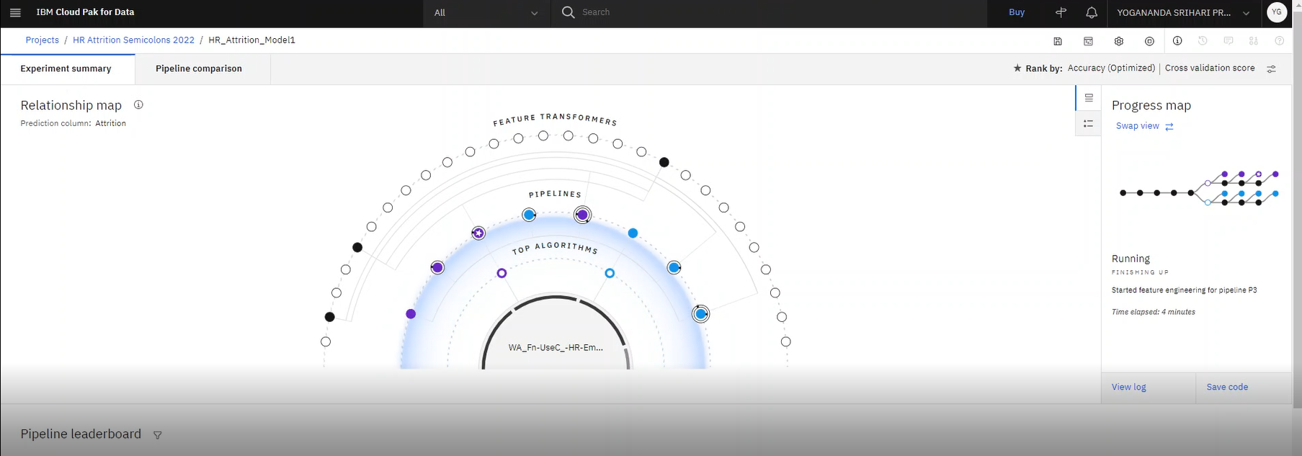
PREDICTION AND RESULT
Confidential © 2022 Persistent Systems

Slide 16
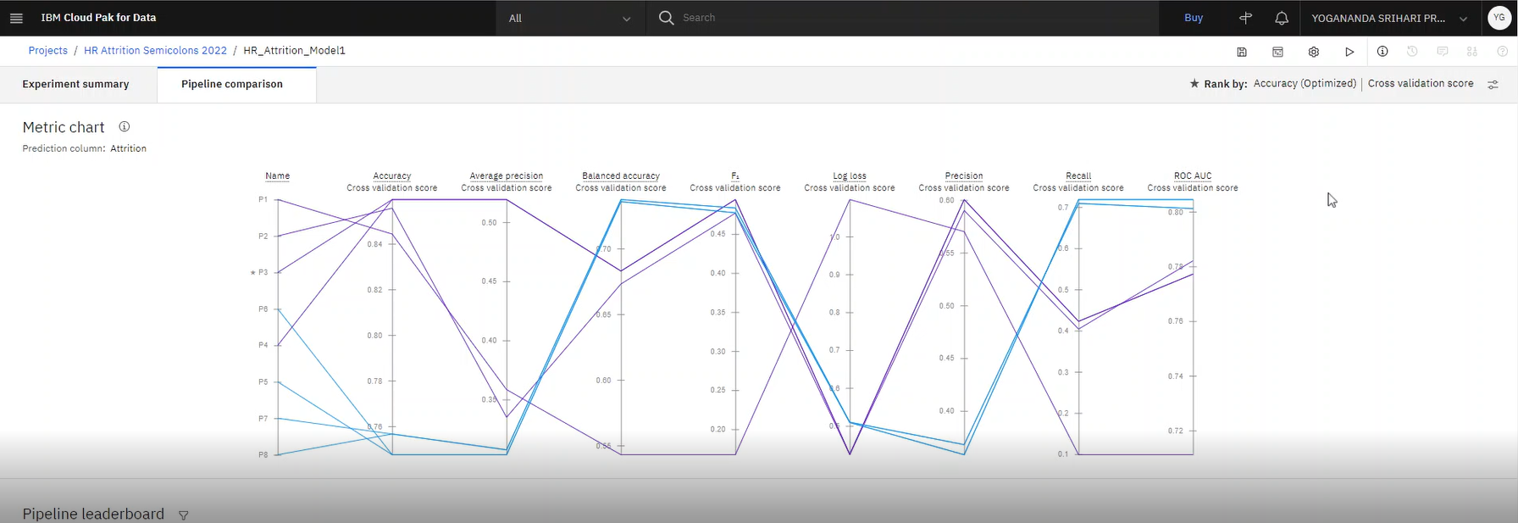
PREDICTION AND RESULT
Confidential © 2022 Persistent Systems

Slide 17
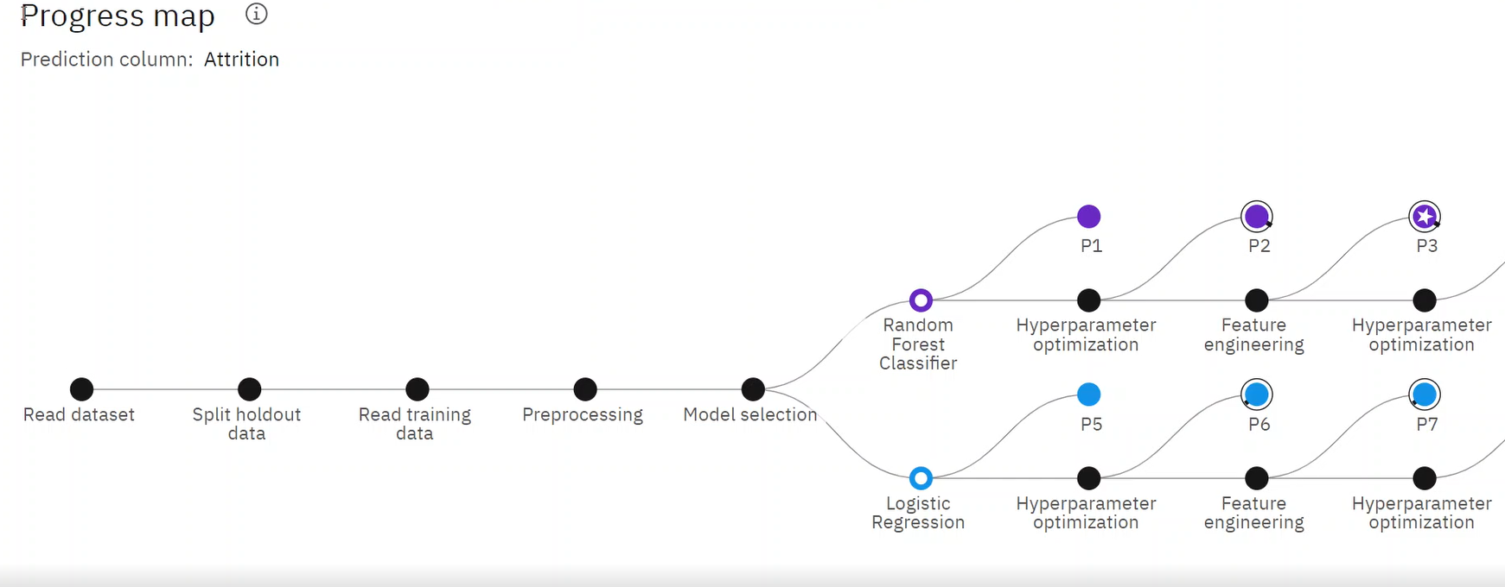
PREDICTION AND RESULT
Confidential © 2022 Persistent Systems

Slide 18
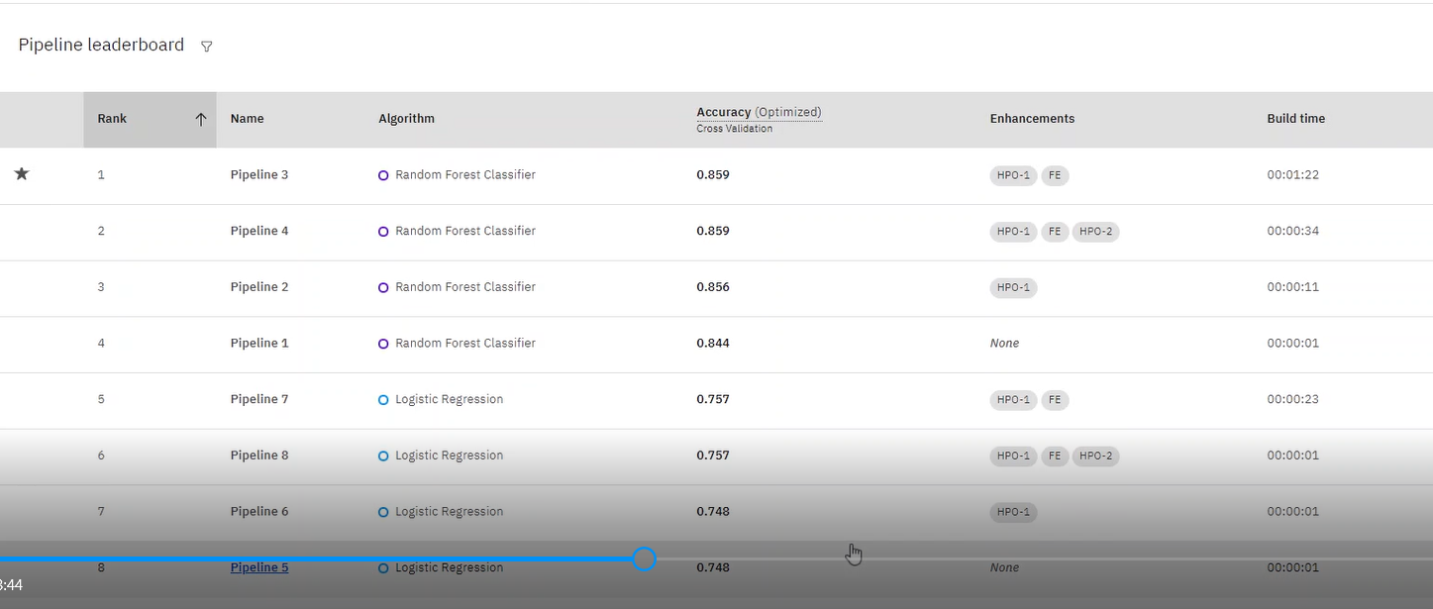
PREDICTION AND RESULT
Confidential © 2022 Persistent Systems

Slide 19
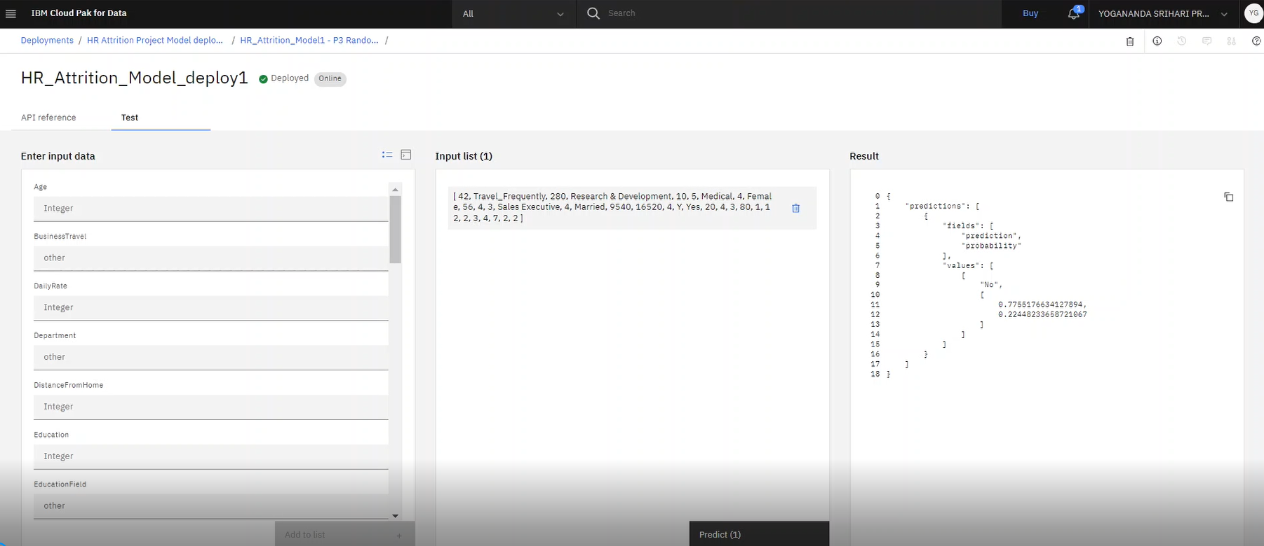
PREDICTION AND RESULT
Confidential © 2022 Persistent Systems

Slide 20
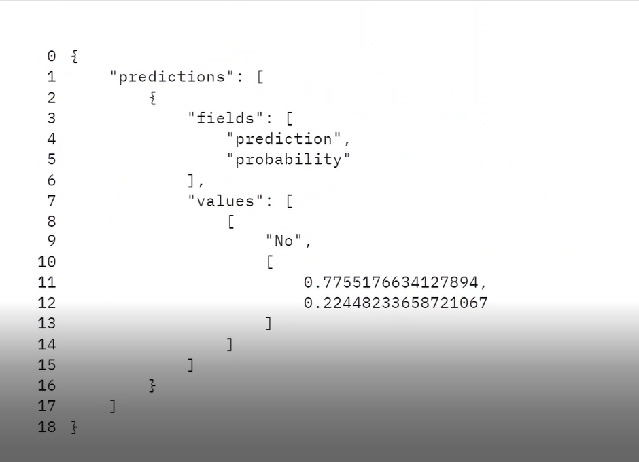
PREDICTION AND RESULT
Confidential © 2022 Persistent Systems

Slide 21
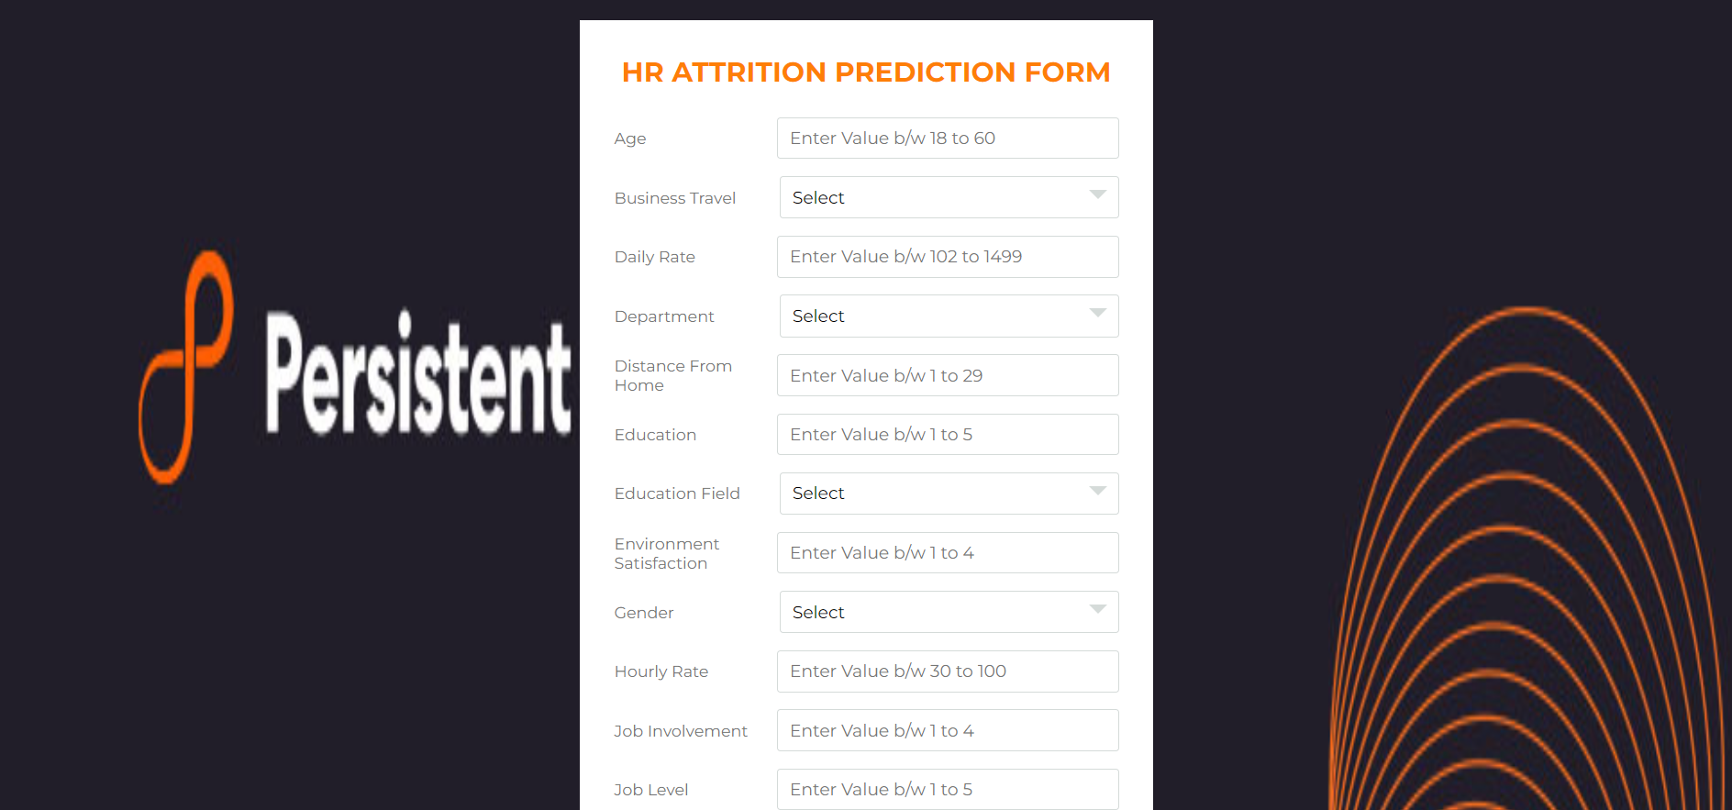
INTEGRATION
Confidential © 2022 Persistent Systems

Slide 22
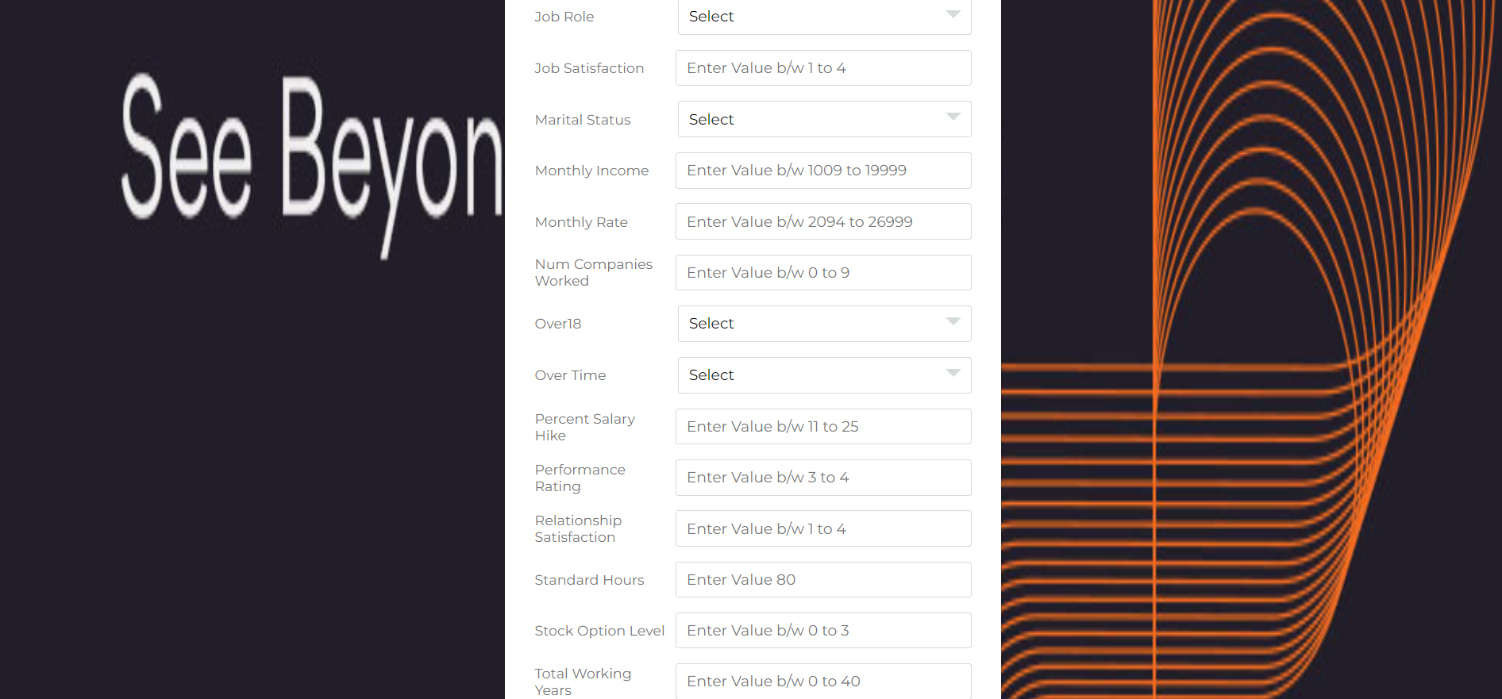
INTEGRATION
Confidential © 2022 Persistent Systems

Slide 23

INTEGRATION
Confidential © 2022 Persistent Systems

Slide 24
BUSINESS VALUE
This model will add on to the bussiness and overall organization working culture as it provides a real time data visibility of an employee to the HR represntatives.
IBM Watson can become a game changer as it provides the most near absolute prediction of attrition of the employee based on the add on it provides .
Our solution will provide a more optimistic if we get access of the external information of the employee as well.
Confidential © 2022 Persistent Systems

Slide 25
Other Privacy Preserving AI Techniques
— Homomorphic Encryption for Machine Learning
Homomorphic encryption enables computation on encrypted data without leaking any information about the underlying data. The training data is encrypted with some secret key, and machine learning model is trained on this encrypted data. The result is also encrypted, and it can be recovered only by the party that possesses the secret key.
— Secure Multi-Party Computation
Secure Multi-party computation allows a set of parties, each with a private input, to securely and jointly perform any computation over their
inputs.
— Confidential Computing Using Secure Enclaves
A secure enclave provides CPU hardware-level isolation and memory encryption on every server, by isolating application code and data from
anyone with privileges and encrypting its memory.
Confidential © 2022 Persistent Systems

Slide 26

Easy-to-use Application
ADDITIONAL BENEFITS
Innovative Solution
A unique solution using latest technologies which allows IBM Watson Studio for training of ML models over sensitive data. Indirectly, the platform enhances access to insights from massive, heterogeneous data.
A platform that can be used by various persona’s such as Data Scientists, Product Managers, HR Managers, ML developers. The UI is easy for navigation, detailing critical information on each steps required for analysis
Business Value
A first-in-market solution in an upcoming and niche field of privacy preserving AI which will make Persistent a flag bearer . Easy-to-scale framework that has brought cutting-edge privacy preserving techniques in one platform. By delivering workshops, POC and implementation, we project revenues of $ 10 M USD over a period of next 2 years.
Take-it-to-customer Demo
A working prototype which can be taken to the customer predicting HR Attrition.
Confidential © 2020 Persistent Systems

Slide 27
Live & Dynamic Dashboard
FUTURE UPDATIONS
Automation using Power Query
Automation Using MS Excel.
Dynamic Dashboards
Chatbot Integration
Chatbot Integration to our Website
Website Intelligence
Like Alexa, Google Assistant, Better assistance for Visualizations in our website.
Confidential © 2020 Persistent Systems

Slide 28
User Experience
Q & A
Business Value
A unique solution using latest technologies which allows IBM Watson Studio for training of ML models over sensitive data. Indirectly, the platform enhances access to insights from massive, heterogeneous data.
A platform that can be used by various persona’s such as Data Scientists, Product Managers, HR Managers, ML developers. The UI is easy for navigation, detailing critical information on each steps required for analysis
Technology & Innovation
A first-in-market solution in an upcoming and niche field of privacy preserving AI which will make Persistent a flag bearer . Easy-to-scale framework that has brought cutting-edge privacy preserving techniques in one platform. By delivering workshops, POC and implementation, we project revenues of $ 10 M USD over a period of next 2 years.
Execution
A working prototype which can be taken to the customer predicting HR Attrition.
Confidential © 2020 Persistent Systems

Slide 29
Thank You
Confidential © 2022 Persistent Systems

